Slide 1
Lab 11

Slide 2
Lab11A
Given a directed network graph with a source and a sink, your task is to calculate the maximum flow from the source to the sink.

Slide 3
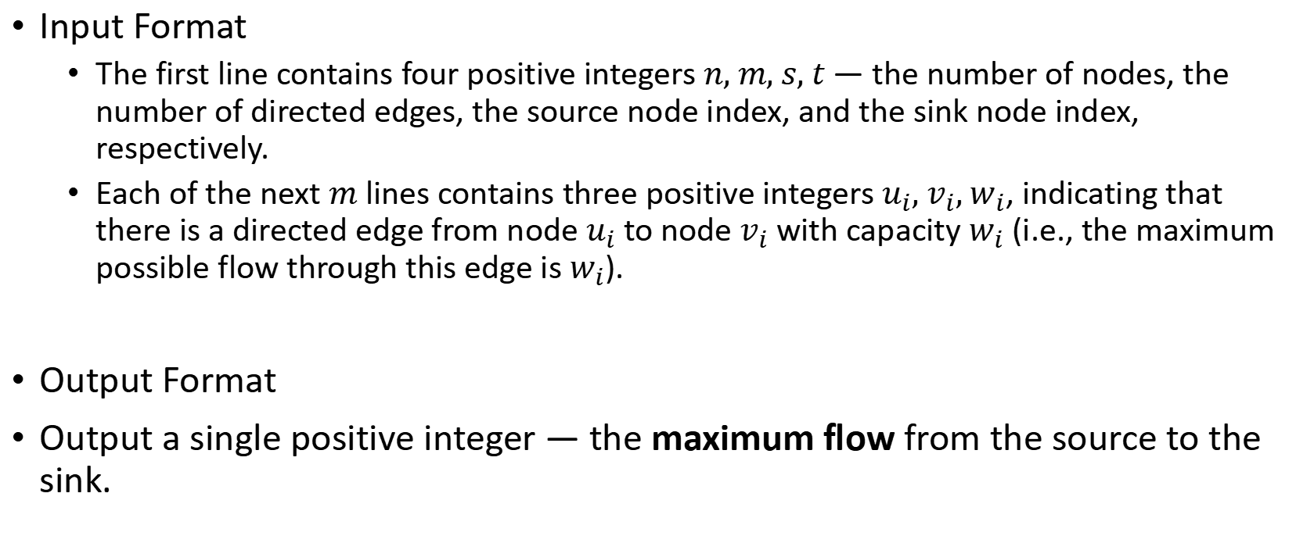
Lab11A
Input Format
The first line contains four positive integers $n, m, s, t$ — the number of nodes, the number of directed edges, the source node index, and the sink node index, respectively.
Each of the next $m$ lines contains three positive integers $u_{i}, v_{i}, w_{i}$, indicating that there is a directed edge from node $u_{i}$ to node $v_{i}$ with capacity $w_{i}$ (i.e., the maximum possible flow through this edge is $w_{i}$).
Output Format
Output a single positive integer — the maximum flow from the source to the sink.

Slide 4
Lab11A
1
30
2
4 5 4 3
4 2 30
4 3 20
2 3 20
2 1 30
1 3 30
30
50
20
30
4
20
3

Slide 5
Lab11A
1
10/30
2
4 5 4 3
4 2 30
4 3 20
2 3 20
2 1 30
1 3 30
10/30
50
20/20
30/30
source
4
20/20
3
sink

Slide 6
Lab11B
Xiaofeng stays in touch with his friends around the world through a computer network. If there's a path of connected devices (computers) between two people, they can exchange messages.
However, sometimes some relay devices (computers) might fail due to accidents or maintenance. Once a device fails, it can no longer be used, and all its connections are cut off as well.
Now, Xiaofeng wants to know: what is the minimum number of relay devices that need to be disabled to completely block communication between him and one of his friends?
All connections in the network are bidirectional.
There is at most one connection between any two devices.
The devices used by Xiaofeng and his friend cannot be disabled.
The goal is to block communication between them with the minimum number of disabled devices.

Slide 7
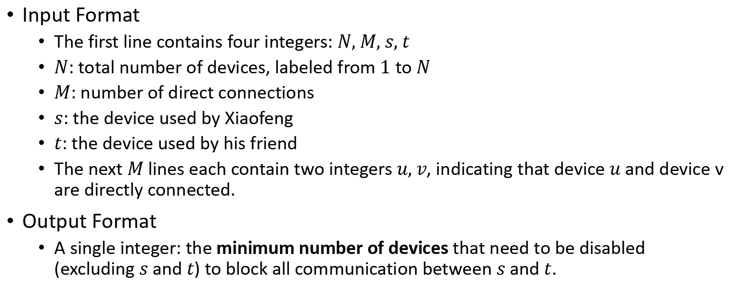
Lab11B
Input Format
The first line contains four integers: $N, M, s, t$
$N$: total number of devices, labeled from $1$ to $N$
$M$: number of direct connections
$s$: the device used by Xiaofeng
$t$: the device used by his friend
The next $M$ lines each contain two integers $u, v$, indicating that device $u$ and device v are directly connected.
Output Format
A single integer: the minimum number of devices that need to be disabled (excluding $s$ and $t$) to block all communication between $s$ and $t$.

Slide 8
Lab11B
1
2
3 2 1 2
1 3
2 3
1
3

Slide 9
Lab11B
xiaofeng
friend
1
2
3 2 1 2
1 3
2 3
1
3

Slide 10
THX:-)

